Slide 1
Improved Neural Machine Translation with Source Syntax
Authors: ShuangzhiWu, Ming Zhou , Dongdong Zhang
Conference: IJCAI 2017
Link: https://www.ijcai.org/proceedings/2017/0584.pdf

Slide 2
Abstract
Researchers have proven that extending word level attention to phrase level attention by incorporating source-side phrase structure can enhance the attention model and achieve promising improvement.
However, word dependencies that can be crucial to correctly understand a source sentence are not always in a consecutive fashion (i.e. phrase structure), sometimes they can be in long distance.
Phrase structures are not the best way to explicitly model long distance dependencies.
This paper proposes a simple but effective method to incorporate source-side long distance dependencies into NMT.
Their method based on dependency trees enriches each source state with global dependency structures, which can better capture the inherent
syntactic structure of source sentences.

Slide 3
Introduction

Slide 4
Recently, inspired by the successful application of source-side syntactic information in statistical machine translation (SMT) [Liu et al., 2006], [Eriguchi et al., 2016b] propose a new attentional NMT model which takes advantage of the source-side syntactic information based on the Head-driven Phrase Structure Grammar [Sag et al., 1999].
They align each target word with both source words and source phrases. This kind of extension is effective to handle cases that one target word may correspond to a fragment of consecutive source words.
However, the long distance syntactic dependencies of the source-side, which can be crucial to correctly understand a sentence, are not explicitly concerned in all previous work.
Although, in theory, the encoder RNN is able to remember sufficiently long history, we can still observe substantial incorrect translations which are both fluent and grammatical but violate the meaning of source sentences.

Slide 5
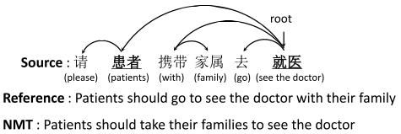
Fig 1 shows incorrect translation example which relates to the source syntax structure.
Though the translation is grammatically correct, its meaning is inconsistent with the source sentence.
In Figure 1, if the dependency between the
root word “(see the doctor)” and its subject word
“(patients)” denoted by a link can be encoded
by the NMT encoder, the NMT model is more
likely to generate a correct translation.
This paper tries to solve the above problem
by leveraging the source-side dependency tree
To explicitly incorporate source word
dependencies into NMT framework.
Based on source dependency trees, each
encoder state is enriched from both
child-to-head and head-to-child with global
knowledge from the dependency structure.
Figure 1: Example of incorrect translation from conventional NMT system. The arrows refer to the dependency link in the dependency tree.

Slide 6
Differences with previous works
The major differences between this work and previous tree based method [Eriguchi et al., 2016b] are in two folds:
(1) The author models source word relations that are important for understanding source sentences, however, previous work focuses on the mismatch problem that one target word may attend to a source phrase (multiple consecutive words).
(2) The proposed model enhances the NMT by enriching each encoder state with global source dependency structure, however, previous work improves NMT model by proposing a phrase level attention.

Slide 7
Background

Slide 8

Sutskever et al., 2014 and Bahdanau et al., 2015
Different from SMT consisting of multiple sub-models, NMT is an end-to-end paradigm directly modeling the conditional translation probability p(𝑌 | 𝛸) of the source sentence 𝛸 = 𝒙₁,𝒙₂,𝒙₃,....,𝒙_{n} and the target 𝑌 = 𝒚₁, 𝒚₂,𝒚₃,....,𝒚_{m} with the RNN encoder and the RNN decoder.
The RNN encoder bidirectionally encodes the source sentence into a separate context vector H = 𝒉₁, 𝒉₂,𝒉₃ ,....,𝒉_{n}, where h_{i} = [ , ], and are calculated by two RNNs from left-to-right and right-to-left respectively as follows
where fRNN can be a Gated Recurrent Unit (GRU) [Cho et al., ] or a Long Short-Term Memory (LSTM) [Hochreiter and Schmidhuber, 1997] in practice. In this paper, we use GRU for all RNNs.

Slide 9


Based on target history and the source context, the RNN decoder computes the target translation in sequence by
Typically, for the 𝑗th target word, the probability 𝑝(𝑦_{𝑗} | 𝑦_{<𝑗} , 𝐻) is computed by
𝑝(𝑦_{𝑗} | 𝑦_{<𝑗} , 𝐻) = 𝗀(𝘴_{𝑗} , 𝑦_{𝑗-𝟣}, 𝑐_{𝑗} ) (2)
where g is a nonlinear, potentially multi-layered, function that outputs the probability of 𝑦_{𝑗}, 𝘴_{𝑗} is the j-th hidden state of decoder RNN, computed by
𝘴_{𝑗} = f_{RNN}(𝑦_{𝑗-𝟣}, 𝘴_{𝑗-1}, 𝑐_{𝑗})
𝑐_{𝑗} is the source context which is calculated by the attention mechanism. The attention mechanism is proposed to softly align each decoder state with encoder state, where the attention score 𝑎_{𝘫𝘬} is computed to explicitly quantify how much each source word contributes to the target word at each time step
The calculation for 𝑒_{𝑗𝑘} can be in several ways [Luong et al., 2015b], in this paper we compute 𝑒_{𝑗𝑘} by
where , 𝑈_{𝑎}, 𝑊_{𝑎} are the weight matrix

Slide 10

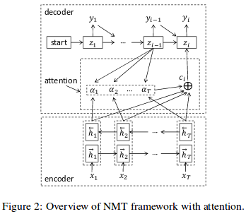
The final source context 𝑐_{𝑗} is the weighted sum of all encoder states
The overview of the attention-based NMT is shown
in Figure 2.
Although the attention mechanism is effective to
model the correspondences between source and
target, the long distance syntactic dependencies in
the source-side still remain a challenged for a
conventional NMT model.

Slide 11
The proposed method

Slide 12
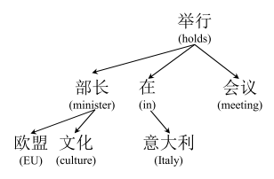
Basic Idea
To incorporate syntactic word relations in NMT, they propose to take advantage of dependency tree.
Each word in the tree has a parent word which it depends
on, except for the root word.
There are no constituent labels in a dependency tree,
the tree directly models word dependencies and syntactic
structures of arbitrary distance.
Given a source sentence 𝛸 = 𝒙₁, 𝒙₂, 𝒙₃,...., 𝒙_{n},
where n is the sentence length, and its corresponding
dependency tree T, we denote as a possible head node
in T, as the leftmost child node (or a leftmost subtree) of ,
w^{h}_{r} as the rightmost child node (or a rightmost subtree) of ,
and , ..., as the rest child nodes (or subtrees) of .
All w belongs to X.
Fig. 3 (a) dependency tree of chinese sentence

Slide 13
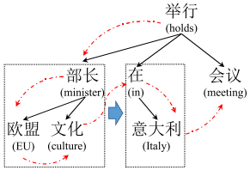
Child Enriched Structure
(CES)
First way of forming a dependency tree

Slide 14
In most previous work which attempts to leverage syntactic structure in neural networks such as [Tai et al., 2015], a bottom-up fashion is used to construct representations for syntactic trees.
Good for whole trees, which can facilitate sentiment analysis or similarity of sentences but useless for seq2seq tasks like NMT. The generation of each target word may depend on arbitrary source word.
Instead of leveraging child nodes to enrich heads, they propose CES to enrich child nodes with global syntactic structures based on the dependency tree.
Two kinds of context are defined in this structure:
(1) is a direct context for .
(2) For a head node , its former child nodes (or subtrees)
are contexts for its latter child nodes (or subtrees).
For example is a direct context for ,
is a direct context for .
In the fig, left subtrees are context for right ones.
eg. entire left box should be context for building right box
To encode this kind of structure in NMT, we use another
sequence generated by the pre-order traversal from the
dependency tree.

Slide 15
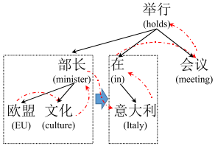
Head Enriched Structure (HES)
Second way of forming a dependency tree

Slide 16
In addition to child enriched structure, we also enrich the head nodes with its child nodes in the head enriched structure (HES). For this structure, another two kinds of context are defined
(1) The first one is the same with the second one in CES.
(2) is a direct context for .
For the construction of sub-tree in the left box, “(EU)”
is first regarded as context for its neighbour “(culture)”,
then “(culture)” is used to enrich “minister)”.
In addition, the former sub-tree in the left box is
context for its neighbor sub-tree in the right box.
To encode this kind of structure for NMT, we use
another sequence generated by post-order traversal
from the dependency tree which perfectly caters
to the above description of HES as illustrated by the
path of dashed arrows in Figure

Slide 17
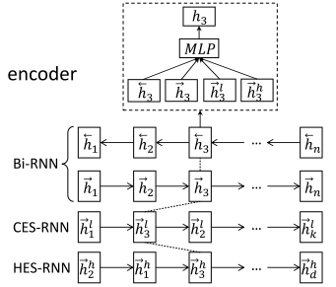
The Computation in Encoder
Two extra RNNs named CES-RNN and HES-RNN are
used to encode the two structural sequences in addition to the bidirectional RNNs (bi-RNN).
Thus for each source word 𝒙_{𝘫}, we have four hidden
state vectors generated by the encoder.
We denote the two hidden vectors for word 𝒙_{𝘫} from the
bidirectional RNNs as and , and denote
as the hidden vector from CES-RNN,
as the hidden vector from HES-RNN.

Slide 18
The final hidden vector 𝘩_{𝘫} used in the decoder is calculated by the four vectors. They are not directly concatenated to avoid the problem of redundancy of information required for decoding.
We apply a MLP function with a smaller hidden size to the four recurrent states before the attention model, as below 𝘩_{𝘫}.
where W_{h}, U_{h}, V_{h} and F_{h} are weight matrices. This allows the model to combine the hidden vectors and filter out redundant information.
The decoder and attention mechanism remains same as the conventional model shown earlier in figure 2.

Slide 19
Conclusion
This paper proposes simple but effective method to incorporate source dependency structure into NMT encoder.
Our model can explicitly model word dependencies in the source sentence.
Experimental results show that our method can achieve promising improvement over the conventional NMT model and outperform the state-of-the-art tree-to-string NMT model.

